Slide 1
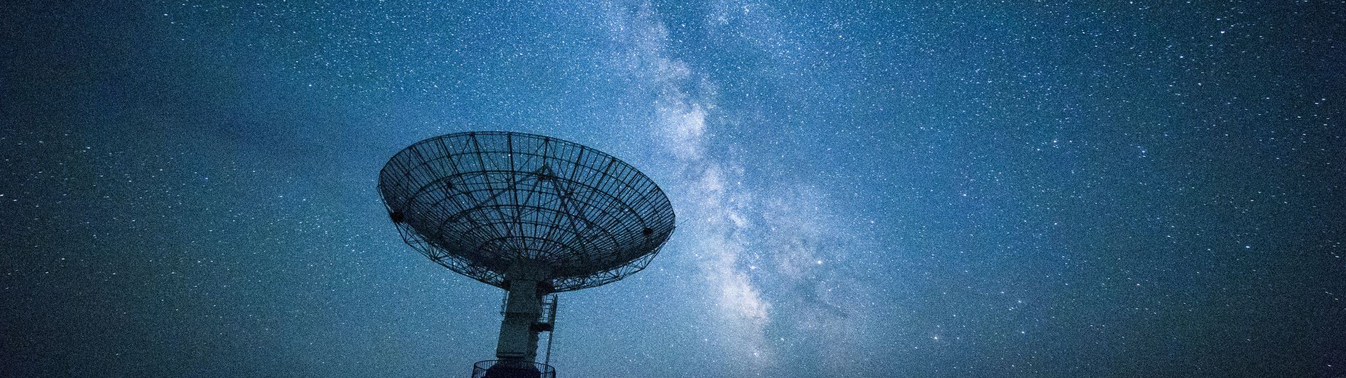
Marsfield Observing Group 4/5
Sagittarius A* and Colliding Wind Binaries
Tan Dung Tu, Angela Sojan, Lachlan Tobin, Mark Sukhov and Ryan White | 06/02/2025

Slide 2
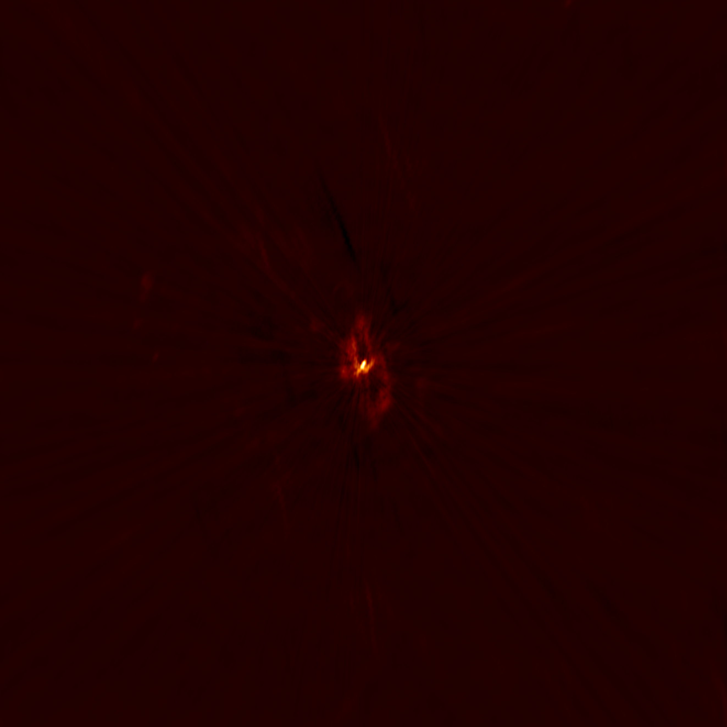
Sagittarius A* @ 5.5GHz

Slide 3
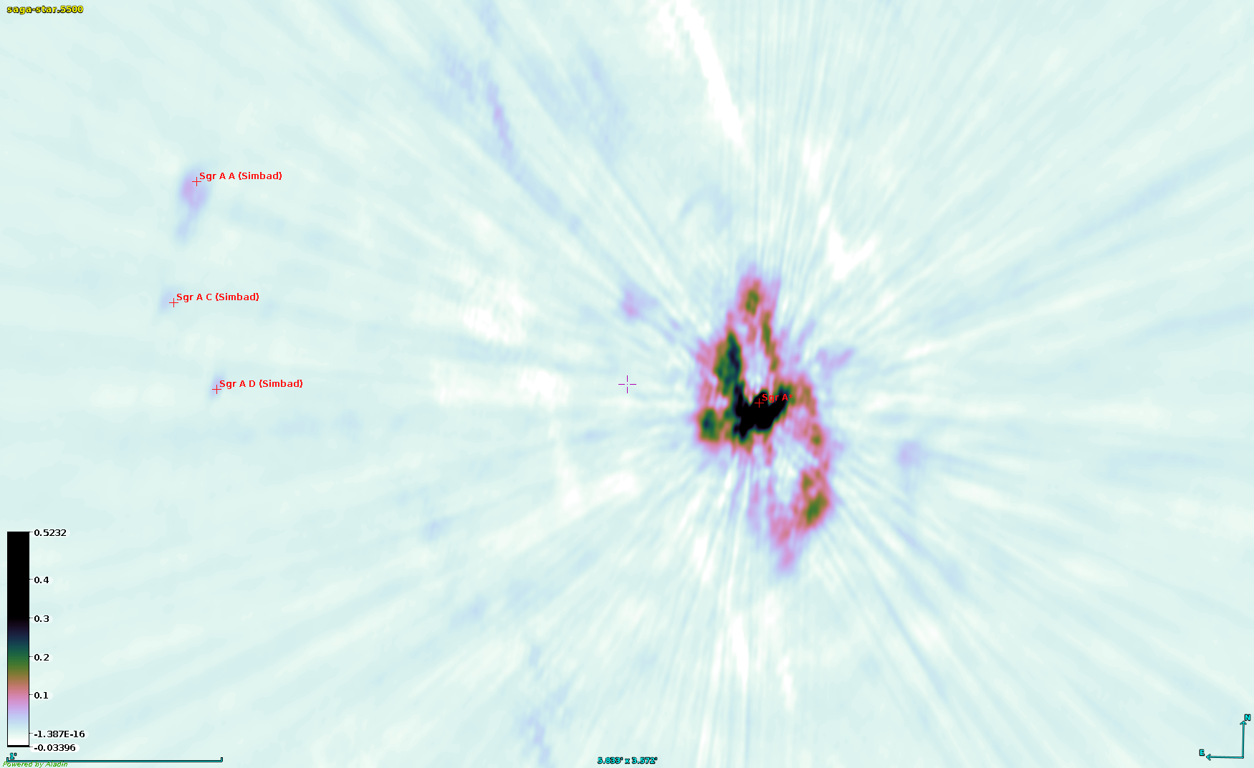
Sagittarius A* @ 5.5GHz: Some nearby sources

Slide 4
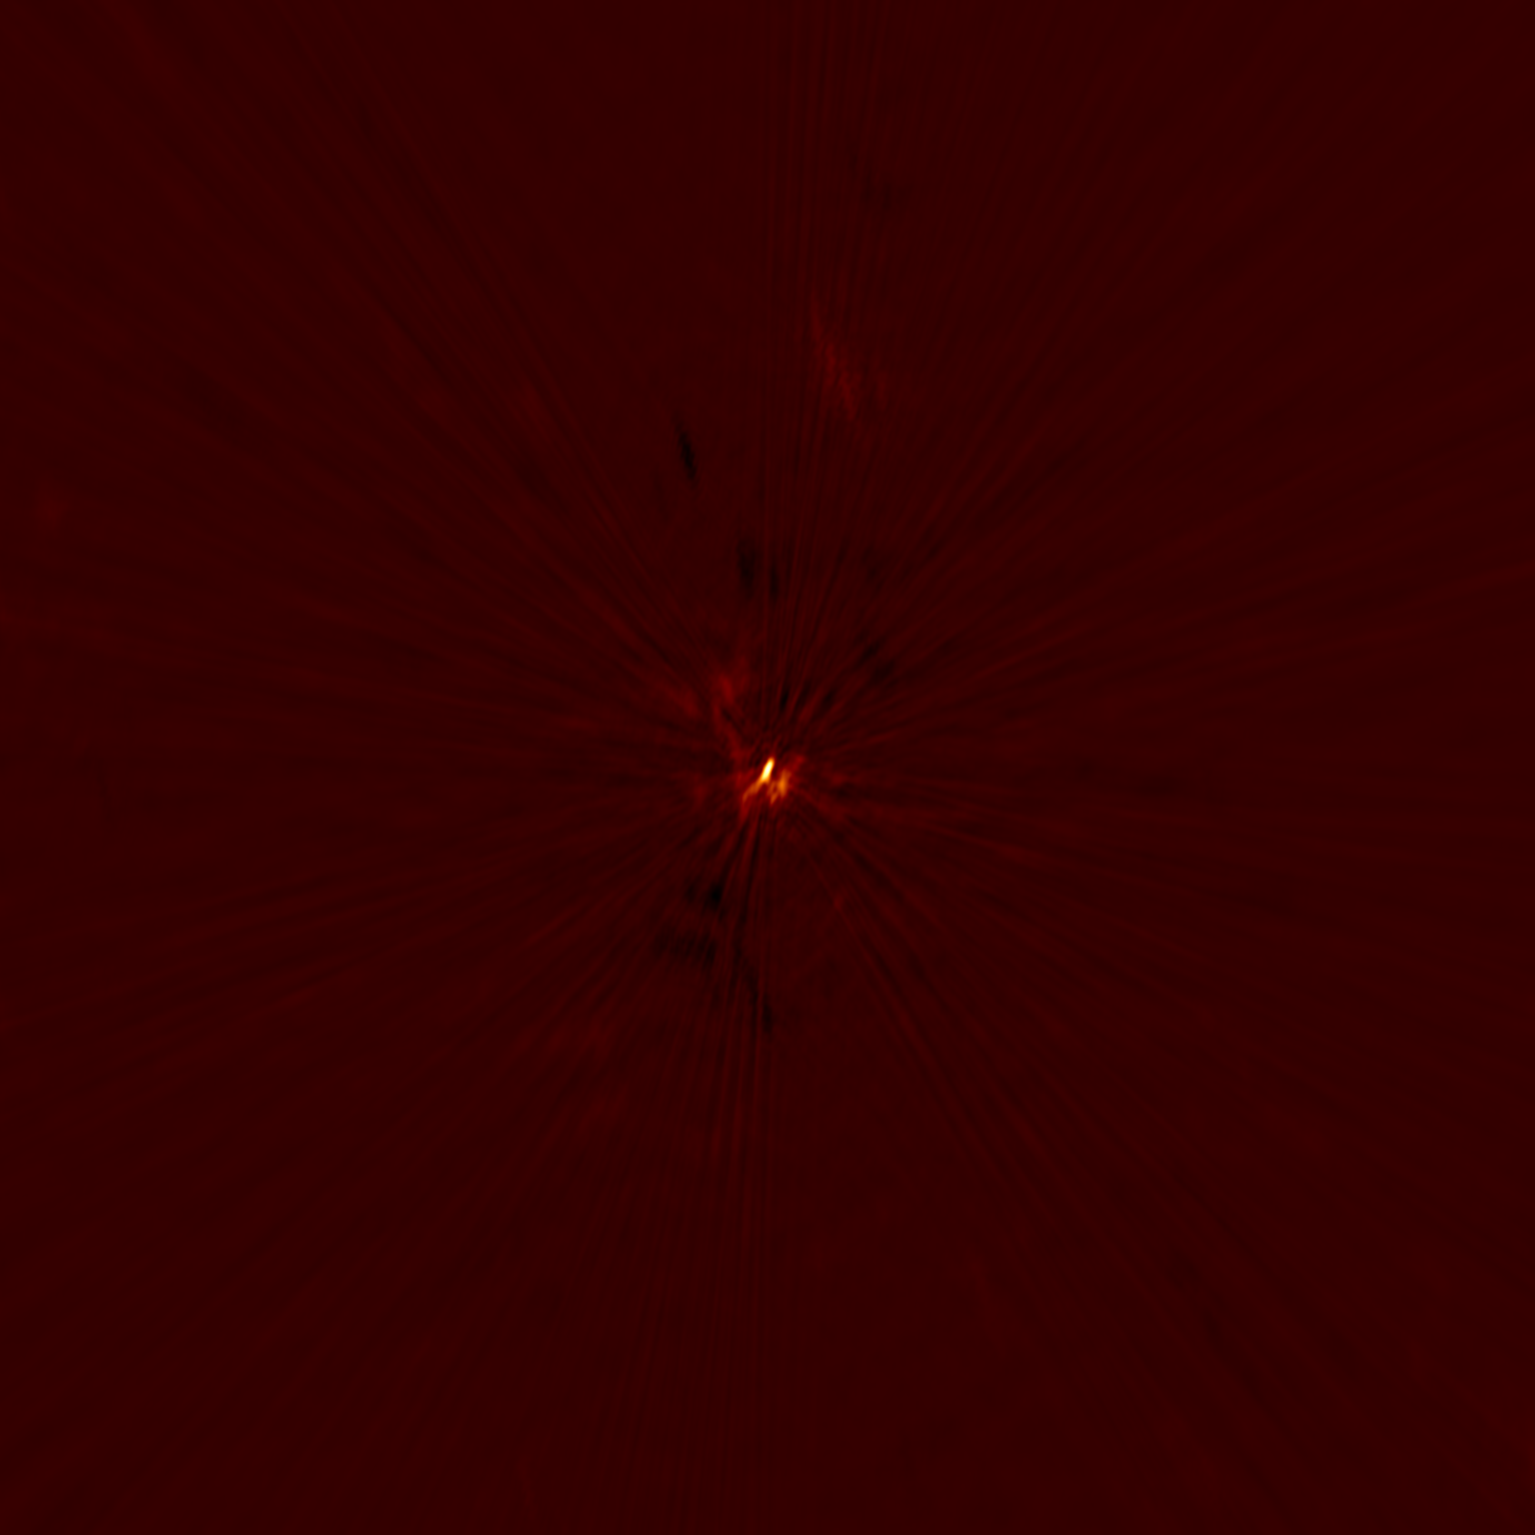
Sagittarius A* @ 9GHz: More RFI

Slide 5
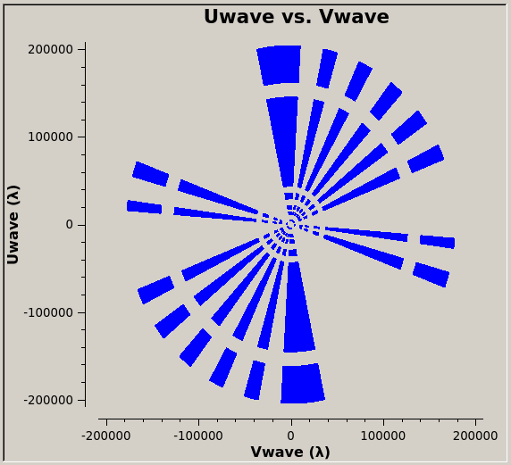
Eta Carinae and Gamma Velorum

Slide 6
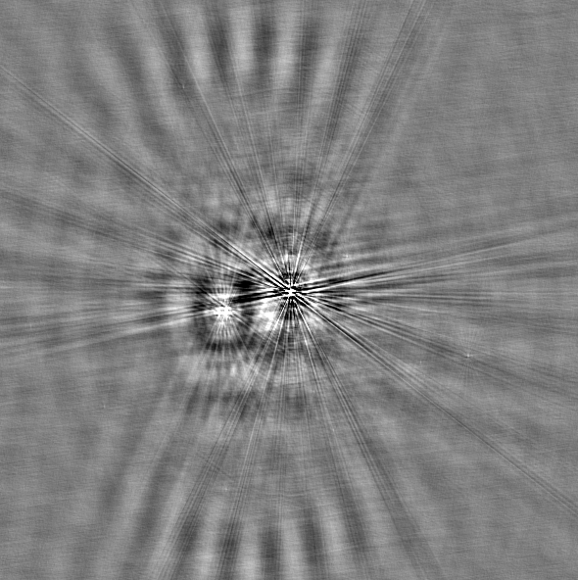
Gamma Velorum @ 5.5GHz
Bright and extended extragalactic source to the east of target
Peak flux of 19.5 mJy/beam

Slide 7
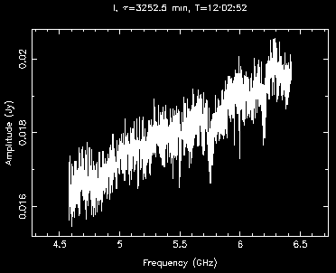
Gamma Velorum @ 5.5GHz
Spectral index of ~0.5

Slide 8
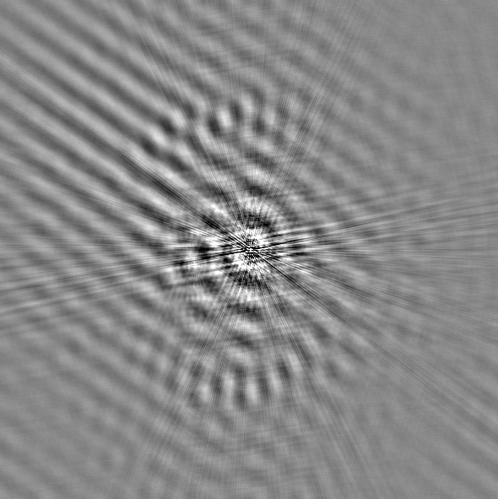
Gamma Velorum @ 9GHz
Peak flux of 22.6 mJy/beam
Integrated core flux of 25 mJy

Slide 9
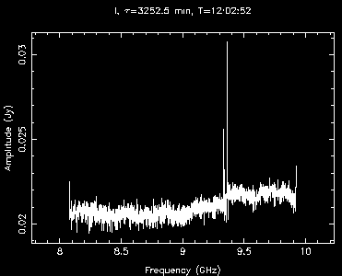
Gamma Velorum @ 9GHz
Spectral index of ~0.16
Strong lines between 9.3 and 9.4GHz are almost certainly RFI, but they are prominent at mid to long baselines

Slide 10

Eta Carinae @ 5.5GHz
The chessboard pattern is a result of poor uv-coverage and a large diffuse blob

Slide 11
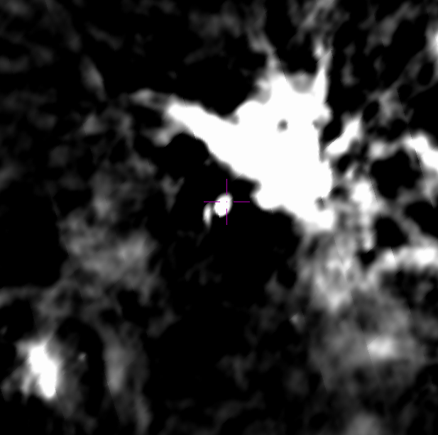
Eta Carinae @ 5.5GHz
The chessboard pattern is a result of poor uv-coverage and a large diffuse blob

Slide 12
Eta Carinae @ 5.5GHz
The chessboard pattern is a result of poor uv-coverage and a large diffuse blob
Lesson learned: get more time when there's junk in the frame
Peak flux of 741 mJy/beam
Integrated core flux of 2.3 Jy

Slide 13
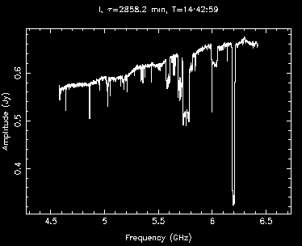
Eta Carinae @ 5.5GHz
The secondary calibrator showed intraday variation
Spectral index of ~0.48

Slide 14
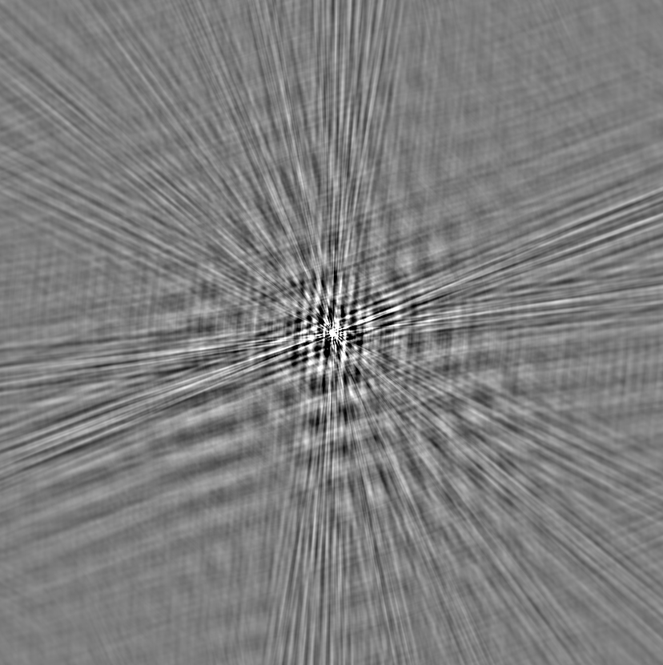
Eta Carinae @ 9GHz
Much more resolved at 9GHz
Peak flux of 801 mJy/beam
Integrated core flux of 3.7 Jy
Lesson learned: get more time when there's junk in the frame

Slide 15
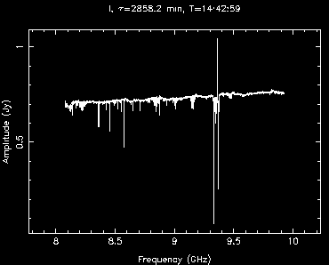
Eta Carinae @ 9GHz
Spectral index of ~0.39
Similar lines between 9.3 and 9.4GHz as in Gamma Vel

